Slide 5
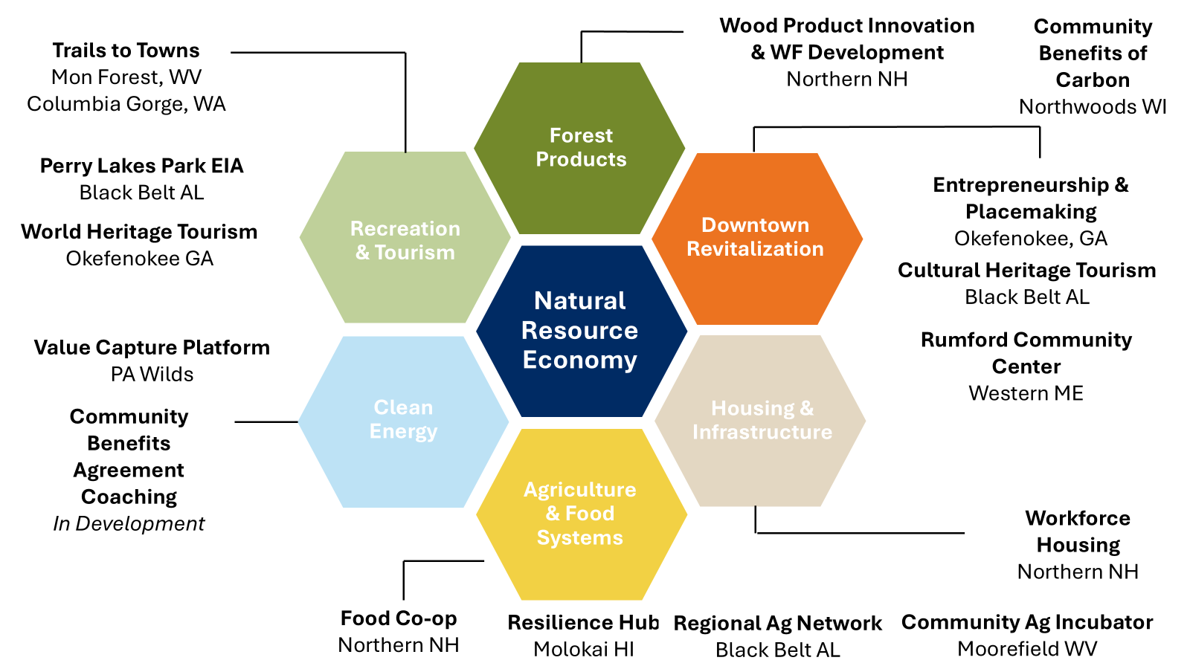

Slide 8
Wolf Creek Park - Quick Facts
Road access from WV-16
936.07 acres
Only about 240 of the acres in Wolf Creek Park are suitable for development due to the property’s terrain. The remaining acreage, mostly found on steep slopes and within the floodplain, is utilized for trails and greenspace. (FCURA Plan, 2020)
Utilities have been extended as far as the WVDEP building, which is currently the last building onsite. Utilities on site include:
Three-phase electric, provided by American Power/Appalachian Power;
Gas provided by Mountaineer Gas, with four-inch gas lines providing an available pressure of MAOP 43mm 100Hg;
Water provided by West Virginia American Water and sewer service from the City of Oak Hill Sanitary Board, with 12-inch supply lines and capacity of 9.4 million gallons per day; and
Fiber served by Frontier Communications, with ethernet access services from 10 Mbps up to 1 Gbps. Fiber has not yet been fully extended to the available 12-acre parcel for sale. It currently extends about 2,000 feet from the available site.

Slide 9
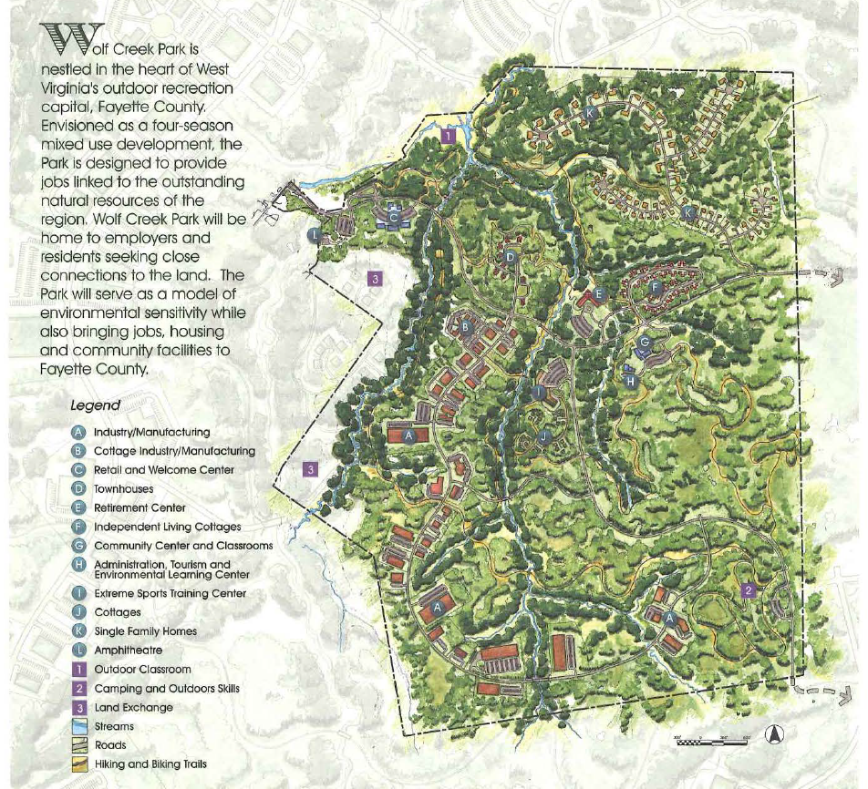
Wolf Creek “Live, Work, and Play” Community Park (circa 2002)
This conceptual plan of Wolf Creek Park included the following components at build-out:
► 21 Manufacturing Sites ranging in size from 1 to 10 acres
► 60 Single Family Home Sites ranging in size from ½ to 2 acres
► 36 Townhouse Units (12 per acre)
► Retirement Community with 75 individual units and 48 assisted units
► Extreme Sports Training Center with dorm, six cottages, and a lodge
► Community Facility anchored around Hospitality Training Center and Environmental Education and Research Center
► Community Building and Conference Center
► 5 acre Retail Center with specialty products produced on site and meeting workers and residents needs
This map was included in the Project Profile document produced by Fayette County Urban Renewal Authority. Partners included: Region 4 Planning & Development Council; Thrasher Engineering; Parsons, Brinckerhoff, Quade & Douglas; and NRGRDA (then 4C)

Slide 10
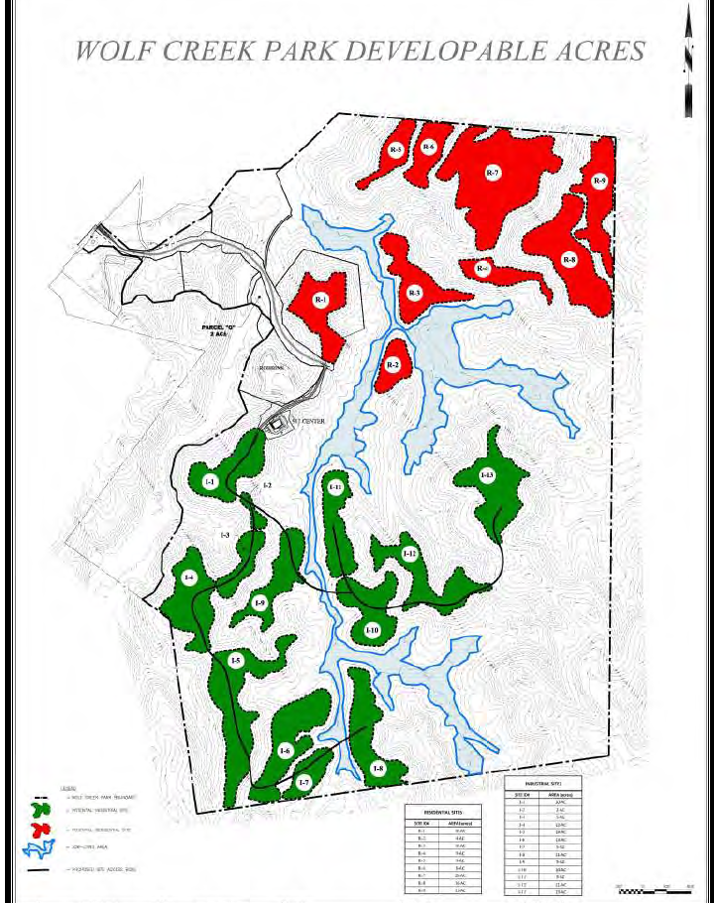
Property appraisal
by Rolston & Company (2016)
936.07 Acres in total
Industrial (approx. 132 acres)
I-1: 10.4 acres @ $50,000/acre = $520,000
3.4 acres sold for construction of WVDEP
7 acres remaining @ $50,000/acre = $350,000
I-2(2ac), I-3(5ac), I-4(12ac): 19 acres
I-5(18ac), I-6(16ac), I-7(5ac), I-8(11ac): 50 acres
I-9(10ac), I-10(10ac), I-11(9ac), I-12(11ac), I-13(13ac): 53 acres
Remaining acreage @ $50,000/acre = $6,450,000
Residential (approx. 96 acres)
R-1: 10 acres sold @ $7,500/acre
R-2(4ac), R-3(10ac), R-4(5ac), R-5(5ac), R-6(6ac), R-7(29ac), R-8(16ac), R9(11ac): 86 acres

Slide 11
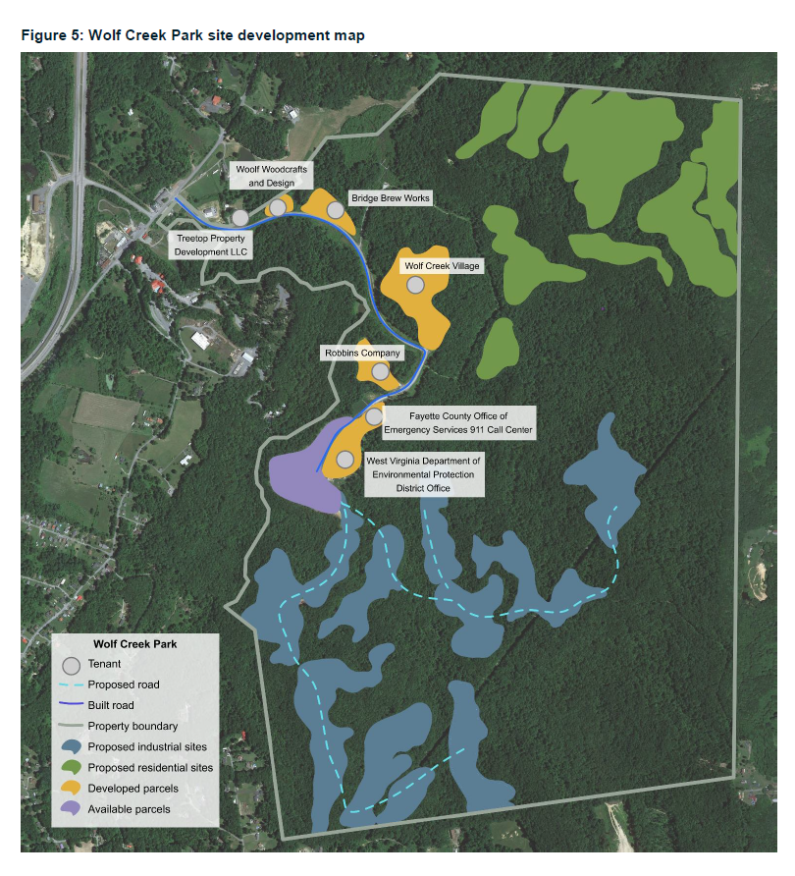
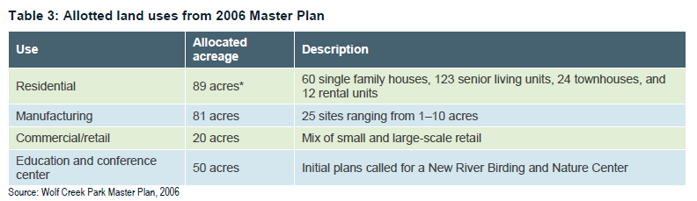
The Fayette County Urban Renewal Plan (2020)
Residential (89 acres) 60 single family homes, 123 senior living units, 24 townhouses, 12 rental units
Manufacturing (81 acres) 25 sites from 1-10 acres
Commercial/retail (20 acres)
Education & Conference Center (50 acres)

Slide 12
New River Birding and Nature Center
NRBNC is an outdoor classroom featuring approximately 700-feet of accessible Wetlands Boardwalk and connecting Woodland Trails passing through a 15-acre beaver-maintained wetland bordering Wolf Creek, showcasing the importance of wetlands and watersheds and providing access to a habitat seldom experienced in West Virginia.
Environmental education programs serve school groups, field trips, families, and individuals through guided walks and in-depth hands-on activity focused on watersheds, wetland ecology, neotropical migrant and resident birds, natural history, botany, and wildlife, unavailable elsewhere in the region. Self-guided nature walks are available to school groups, families, and visitors. Tailored programming and guided field trips are available by request.

Slide 13
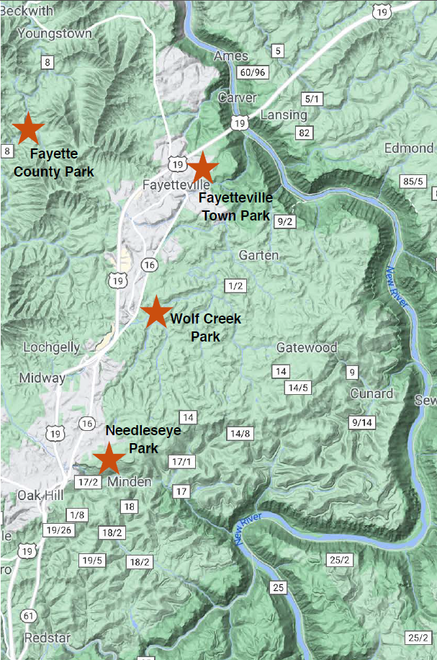
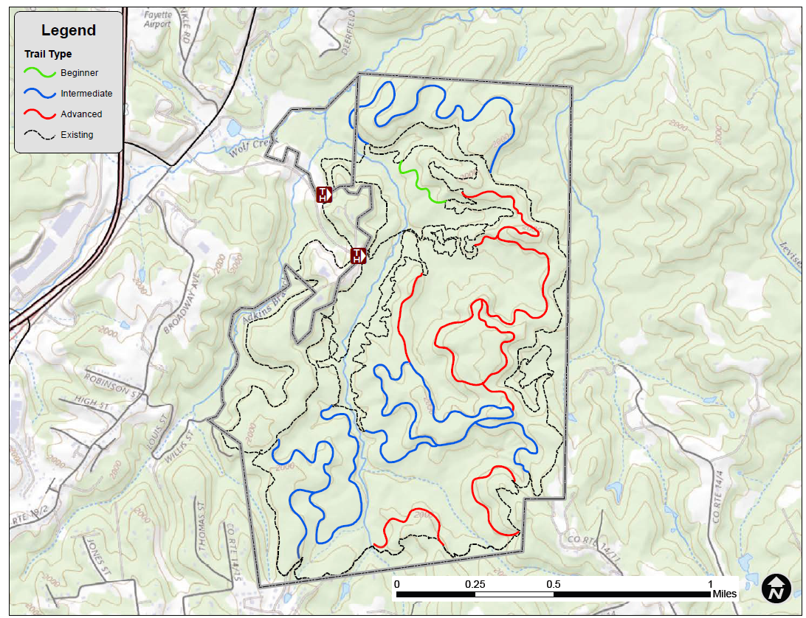
Fayette County Soft Surface Trails Plan (2022)

Slide 14
Site Development Planning Process
► Led by NRGRDA in coordination with Fayette County Commission
► Built-in opportunities for stakeholder engagement
► Asset mapping
► Design feedback
► Planning updates and stakeholder input through Wolf Creek Park webpage on nrgrda.org
Winter ‘25
Spring ‘25
Summer ‘25
Fall ‘25
Feb
March
April
May
June
July
August
September
October
November
December
RFP Creation
Vendor Selection and Contracting
Site Development Planning
Site Development Plan Completed
Ongoing marketing of Wolf Creek Park
Marketing of Wolf Creek Park

Slide 15
Ongoing information about
Site Development Planning at Wolf Creek Park
will be available through nrgrda.org

